Slide 1
"String
Conundrum"
Luvuyo Matomela & Hlomla Kuhlane

Slide 2
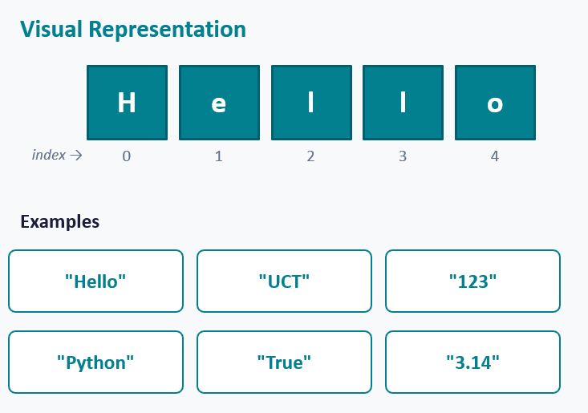
String Introduction
3
Strings are essential for :
Displaying information to users
Processing input
Creating error messages
Building text-based applications

Slide 3
What's the deal
3
1 in 3
50+
37M
students fail intro
programming globally
years failure rate
has not changed
compilations analysed —
string errors hardest to fix
At UCT
Student marks consistently drop when string concepts are introduced

Slide 4
Problem
Statement

Slide 5

Non-intuitive
Index Confusion
Wrong Comparison
String immutability contradicts how most beginners think about variables. Modifying a string creates a new object students expect in-place change.
Zero-based indexing conflicts with everyday counting. Students consistently start counting from 1 and produce off-by-one errors.
String comparison behaves differently from numeric comparison in ways students do not anticipate, causing silent logical errors.

Slide 6
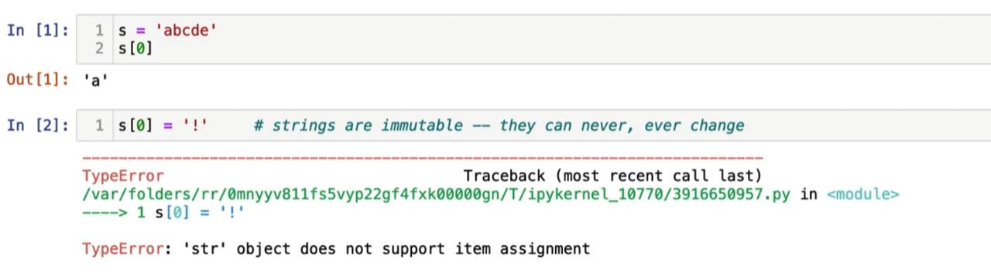
Example
6
assumes the student understands “object”
doesn’t explain immutability
doesn’t tell them what they did wrong in simple terms

Slide 7

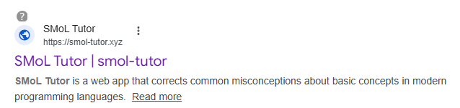
Issues with Existing Tools
The Gap
No tool targets string misconceptions specifically
Behaviour is made visible but never explained
No misconception-targeted feedback for strings
Students must infer understanding on their own

Slide 8
Project Aims

Slide 9

Project Aims
Measure learning gain through pre and post testing with UCT first-year Python students
Visualize Strings
Accept Python string code, execute it, and transform the result into the visual representation
Present string concepts from fundamental to complex using multiple-choice and fill-in-the-blank exercises
Identify the specific misconception behind every wrong answer and explain it in plain language
Evaluate Learning
Targeted Feedback
Live Code Pipeline
Structured Progression
Display strings as indexed character sequences with dynamic highlighting during operations

Slide 10
Feature
Concepts

Slide 11
Basic Example
word[2] — single character highlight
p
y
t
h
o
n
word
0
1
2
3
4
5
→ Index 2 highlights
p
y
t
h
o
n
0
1
2
3
4
5
word[1:4] — slice highlight
p
y
t
h
o
n
0
1
2
3
4
5
→ Boxes 1, 2, 3 highlight | Box 4 remains unhighlighted (exclusive end bound)

Slide 12
Live Code Pipeline
INPUT · Python
OUTPUT · Visualiser
s = "HELLO"
print(s[1])
H
E
L
L
O
Result: "E"
0
1
2
3
4
1
Receive
2
Parse
3
Sandbox
4
Visualise
Code POSTed
to Flask
Python AST
validates code
Subprocess runs
with CPU/mem limits
Returns JSON
string state

Slide 13
Learning View
MODULE 2 · IMMUTABILITY
MISCONCEPTION-TARGETED FEEDBACK
What is printed by the code below?
Strings cannot be modified in place
s = "cat"
s[0] = "b"
print(s)
Your answer suggests strings work like lists — that you can change one character. In Python, strings are immutable: writing s[0] = "b" raises a TypeError. To change a string, build a new one:
A
"bat"
✕
B
"cat"
s = "b" + s[1:]
print(s) # "bat"
C
TypeError
✓
Try again →
Progress · Module 2 of 6
D
"b"

Slide 14
Learning programming requires the construction of appropriate mental models of program execution
Amal Khaled Altadmri & Neil C. C. Brown (2015)

Slide 15




System Architecture
View
React frontend rendering UI and string visualizations
Controller
Flask backend handling logic and code execution
Model
Firebase DB storing user progress and results
Hosted on UCT CS Server (Nightmare)

Slide 16
Ethics & Legal
Compliance Checklist
Ethical, Professional & Legal Issues · submission deadline 11 May 2026
✓
REC clearance
Faculty of Science Research Ethics Committee approval obtained before any participant recruitment or testing begins.
✓
Informed consent
Voluntary participation; signed consent form; participants may withdraw at any stage without consequence.
ETHICS APPROVED · UCT · FACULTY OF SCIENCE
✓
Anonymised data
No personally identifying information stored. Progress and answer data anonymised, used solely for evaluation.
✓
Open-source IP
Intellectual property owned by UCT per university policy. Source code released open-source via Research Contracts.

Slide 17
Evaluation
01
02
Functional Testing
Usability Testing
Unit tests on every REST endpoint and sandbox boundary, run on every commit via GitHub Actions
15–20 first-years in think-aloud sessions. SUS score benchmarked against published thresholds.
03
04
Comparative Learning
Performance & Stability
Pre/post-test with experimental and control groups. T-test with reported Cohen's d effect size.
Locust load tests verify 20 concurrent users at sub-2-second response time before recruitment.
Functional · Usability · Learning · Performance

Slide 18
Expected Outcomes
02
01
ACADEMIC
03
TANGIBLE
Improved student performance in string-related coursework at UCT
04
COGNITIVE
Deployed web app visualiser, code pipeline, exercises, feedback engine
COMMUNITY
Students develop correct mental models of string behaviour
Tool released openly for adoption by other institutions

Slide 19
Key Success Factors
How we'll know we've succeeded, measurable criteria, set up front
MODULES
SUS SCORE
SIGNIFICANCE
ACCURACY
100%
>68
p<0.05
100%
Full Deployment
Usability Threshold
Learning Gain
Targeted Feedback
All string concept modules functional and accessible through any browser, no install required
Students rate the tool above the established SUS benchmark in first-year usability testing
Statistically significant pre/post-test improvement reported with Cohen's d effect size
Feedback engine identifies the correct misconception for every wrong answer across modules

Slide 20
Top 4 Project Risks
Feature creep (High)
Stick to five core aims
1
Academic workload delays (High)
Weekly project time; track Gantt; descope if needed
2
Ethics clearance delay (Medium)
prep instruments in advance
3
Backend execution security (Medium)
Subprocess sandbox with CPU/mem limits; block unsafe imports
4

Slide 21
Timeline
6th Jun
5th Jul
30th Jul
10th Aug
10th Sep
Initial setup of the entire system and UI mockups
Development cycle 1. Main Features completed.
Development cycle 2 including. Including all 3-4 modules + User Testing
Development cycle 3. Improving on application + including User Testing
Final code Submission 10 September 2026

Slide 22




team work distribution
Luvuyo Matomela
Hlomla Kuhlane
Backend
Frontend
Develops the backend system and data pipeline
Implements the sandboxed Python execution engine
Builds misconception detection
Generates targeted feedback for student errors
Manages Firestore database operations and scoring systems
Designs REST APIs for communications
Develops all user-facing components using React
Designs UI and user flows
Implements string visualisation and interactions
Manages user input, navigation, and feedback display
Builds dashboard, scoring, and leaderboard features
Integrates Firebase authentication (login & signup)
Flora Berggren
Rajesh Santoshi
Chief Operations Officer
VP Marketing

Slide 23
Summary
String Conundrum addresses a key challenge in programming education: students struggle to understand string concepts at a conceptual level
Existing tools provide partial support but fail to target string-specific misconceptions
Our solution introduces a web-based interactive system that combines:
Visualisation
Code execution
Structured learning
Targeted feedback
The system is designed to help students build correct mental models, not just produce correct code
Through evaluation, we aim to demonstrate improved understanding, performance, and confidence
Feature Creep: Given enough time a transpiler will be added to compile from python to isiPython

Slide 24
Thank you
Mtmluv001@myuct.ac.za
Khlhlo002@myuct.ac.za

